Slide 1
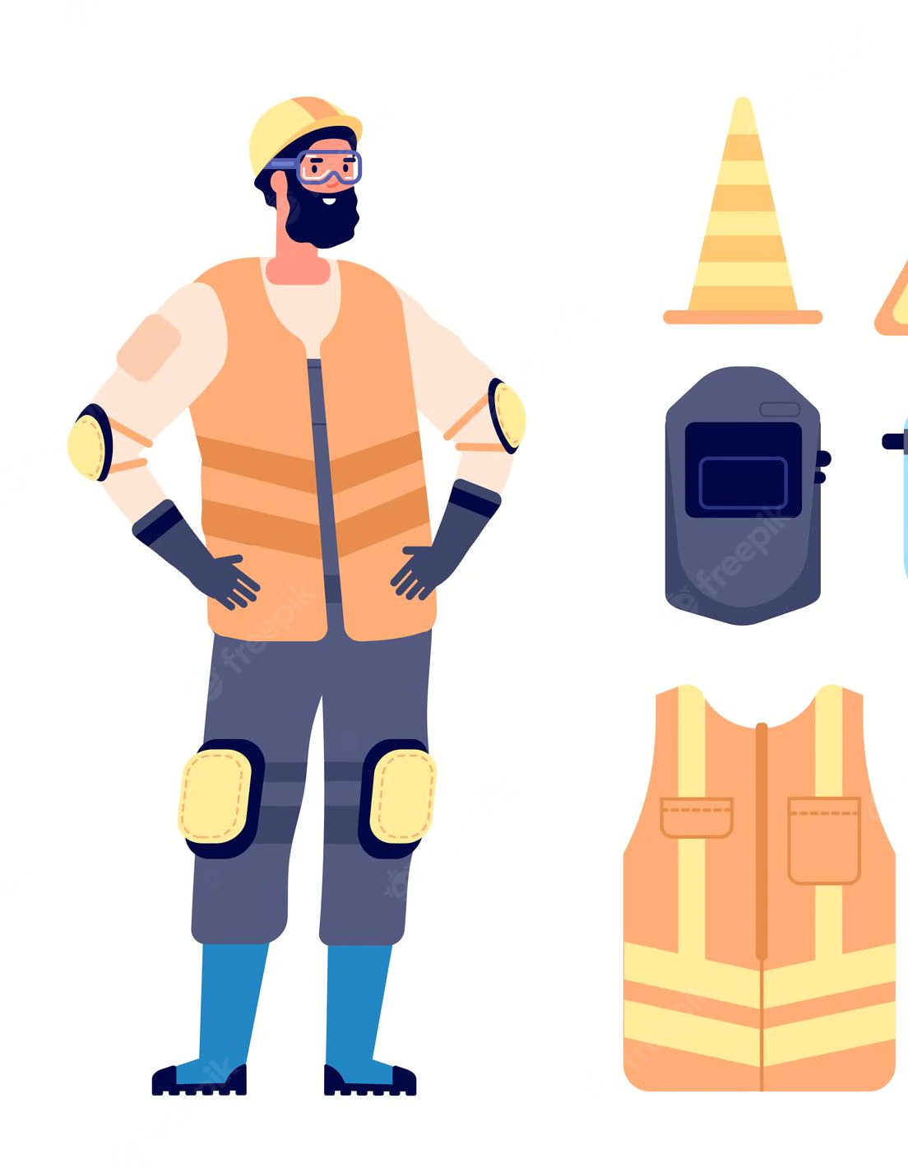
CH 13 HEALTH SAFETY & SECURITY AT WORKPLACE
Nilesh S, X-E

Slide 2





Agenda
1
1
2
3
Introduction
Health
Safety
Security

Slide 3

HEALTH:
Health of an employee is the state of the physical, mental and social well being.
Every organization provide healthy and safety working environment for their employees at the workplace.
Health of an employee must be in a good condition so that the employees of the organisation will not suffer from any diseases. Cleanliness at the workplace is mandatory.
The work places must be cleaned in the morning before the people start working. If it is neat and clean then the people will feel happy to work in that environment

Slide 4
A properly filtered water facility must be available for the employees of the company. A fresh food cafeteria must provide the good quality food for the employees
This will help to maintain the health of the employee. The organisation should maintain a clean washroom facility in good condition to be used by the employees.

Slide 5
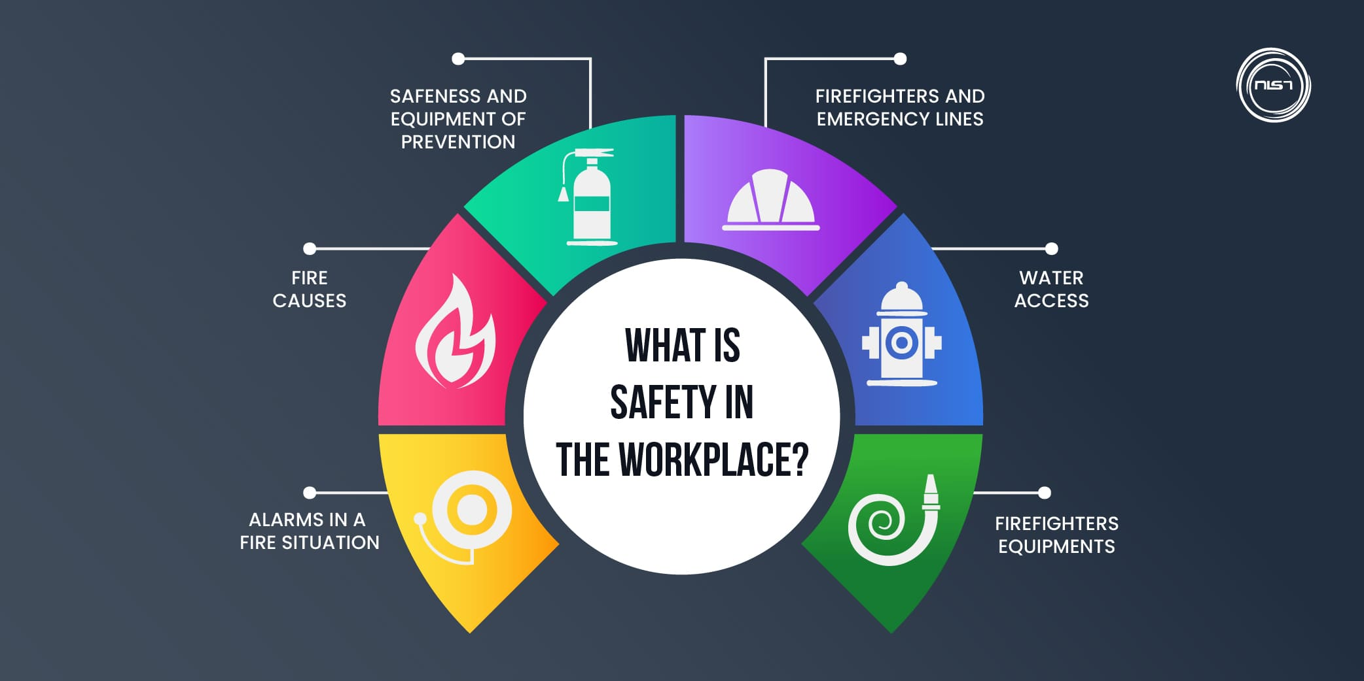
SAFETY AT WORKPLACE
The work environment of the organisation must be safe. It must be free from hazards and risk. A hazard is the something that can cause harm to the people

Slide 6

The work environment of the organisation must be safe. It must be free from hazards and risk
A hazard is the something that can cause harm to the people. A risk is a probability of causing harm to the people.
A proper safety guidelines must be prepared by the company and it should be strictly followed
At regular intervals of time, the safety procedures must be practised by employees.

Slide 7

SECURITY AT WORKPLACE
Every employee working in an organisation must feel that they are secured in the company campus. Security is a kind of freedom from any potential harm.

Slide 8
Happiness has many roots, but none more important than security.
“
”
E.R. Stettinius, Jr.

Slide 9
Every employee working in an organisation must feel that they are secured in the company campus.
Security is a kind of freedom from any potential harm. Security ensures the safety of the people working in the organisation.
Every organisation must have separate security department. This department should be responsible for various security such as personal safety, computer system safety, electrical safety, transport safety and other equipment safety
The proper security procedures will reduce liabilities, insurance and compensation for organisation. This will increase the business revenue and will reduce the operational charges of the company.

Slide 10

Policies and Procedures for Health, Safety and Security
A health, safety and security policy is a written statement by an employer stating the company’s commitment for the protection of the health, safety and security of employees and to the public.
A health, safety and security program/policy contains the health, safety and security elements of an organisation and objectives which make it possible for the company to achieve its goal in the protection of its workers at the workplace.

Slide 11
A health, safety and security policy is an endorsed commitment by management to its employees regarding their health, safety and security.
The government has a specific section mentioned in their company laws, which states the minimum requirements to be followed for health, safety and security programme.
Each employer or company should follow these requirements. Apart from that the company should also have their own health, safety and security committee to determine the hazards present at the workplace

Slide 12
Reasons for Health, Safety and Security Programs or Policies in Workplace
It clearly indicates the company’s commitment for their employee’s health and safety.
It shows the performance of the business and the safety performance are compatible with each other.
It clearly state that the company is not only doing the business for profits but it is taking care of all its stake holders.
The accountability of every one working for the company is outlined for the workplace health, safety and security;

Slide 13
Reasons for Health, Safety and Security Programs or Policies in Workplace
Company can comply national policy on Occupational Health and Safety (OH&S) of Government of India
Injuries and illness of the employees is prevented through such policy

Slide 14
OH&S CLAUSES OF AN IT COMPAY
​
Adopt measures and processes that focus on the prevention of occupation related accidents, injuries, illnesses, and near-misses and strive to continuously improve such processes.
Ensure OH&S awareness and build competency associated at all levels to handle individual OH&S responsibilities
Provide adequate resources to ensure continual improvement in its OH&S performance.
Comply with relevant OH&S legal and other requirements applicable to the organisation and drive for ‘beyond compliance’ leadership.
Set appropriate OH&S objectives & targets and conduct periodic performance reviews against these targets.

Slide 15
Workplace Hazards
Definition of
Hazard
The most common definition of hazard is ‘a danger or risk’ that is associated with something.
Workplace hazards poses potential harm to people at work, and that can cause damage to the work environment and everything else in it
Classification Of Hazards
The most common classifications of hazards are,
Physical Hazards
Electrical Hazards
Fire Hazards

Slide 16




Classification Of Hazards
Physical Hazards
Electrical Hazards
Fire Hazards
Health Hazards

Slide 17
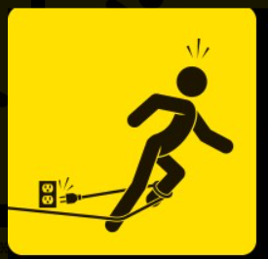






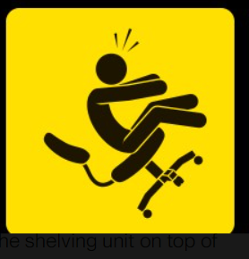
PHYSICAL HAZARDS AT WORKPLACE
Tripping Off Wires
Falling Off Heights
Slipping
Biohazard
Lifting Heavy Weights
Falling Objects
Sharp Power Tools
Falling Off Wheeled Chairs

Slide 18
Physical Hazards :
It is the risks arising from the physical work environment – floors, facilities, walls, and ceilings
Physical hazards could also mean working with machinery and electricity operated machines.
There is a vast list of physical hazards across all industries, but when we look at one specific sector, these hazards are also specific to the work setting.

Slide 19
Falling Off Heights, Slipping and Tripping
The reasons for falling are attributed to faulty scaffolding and ladders, as a result of contact with electricity, and slipping or crashing into anything that throws the worker off balance
On the other hand, trips and slips occur right on lower levels, particularly the floor, on ramps and any uneven surface in the workplace
Various injuries result from simply tripping over things at work, while many more accidents occur when employees slip on the floor, from motorized vehicles or from scaffolding or ladders

Slide 20
Preventing Physical Hazards
To avoid falls and slips, all things must be arranged properly
Any spilt liquid, food or other items such as paints must be immediately cleaned to avoid any accidents
Make sure there is proper lighting
All damaged equipment, stairways and light fixtures must be repaired immediately.
All Tools and Equipment must be arranged properly in their belonging placed

Slide 21
Electrical Hazards
There are many reasons why workers get electrocuted or suffer from electric shock at work
At work, the common causes of electrical accidents are exposed, worn-out wiring, overloading of electrical outlets, ungrounded or faulty equipment, and unsafe use of electrical equipment
Electrical technician and engineers should carry out routine inspections of all wiring to make sure there are no damaged or broken wires
For the most part, it’s due to coming in direct contact with live wires, or having indirect contact through a conductor
Employees must be provided basic knowledge of using electrical equipment and common problems

Slide 22
Fire Hazards :
Each establishment must comply with housekeeping standards to ensure fire safety.
Everyone not follows such requirements, and this leads to accidents resulting to fire. Such incidents not only damage the vital workplace equipment, stock and other items, and the building.
To avoid fire, it is important to observe safety precautions at workplace. The whole organisation must also have first response and emergency mitigation systems in place.

Slide 23
Heath Hazards
Definition
Health refers to the physical well-being of the workers, and this includes the condition of their skin, eyes, ears and all other body part
But it also includes the health situation of what we cannot see upfront – their respiratory and cardiovascular system, and the nervous system
Health
Hazards
Hazards are present in most workplaces that could impact any part of the human body
For example, a noisy machine or factory environment could damage the sense of hearing of the workers

Slide 24
Potential Sources Of Hazards In An Organization
​
Bright light sources behind the display screen can create contrast problems, making it difficult to clearly see your work
Use blinds or drapes on windows to eliminate bright light. Blinds and furniture placement should be adjusted to allow light into the room, but not directly into your field of view
Use indirect or shielded lighting where possible and avoid intense or uneven lighting in your field of vision. Ensure that lamps have glare shields or shades to direct light away from your line of sight.
Reorient the workstation so bright lights from open windows are at right angles with the computer screen
Hazards using Computers :
Hazards while using computers include poor sitting postures or excessive duration of sitting in one position.
These hazards may result in pain and strain. In addition, glare from the computer screen can be harmful to the eyes. Stretching at regular intervals or doing some simple yoga in your seat can mitigate such hazards.

Slide 25
Handling Office Equipment:
Improper handling of office equipment can result in injuries.
For example, sharp-edged equipment if not handled properly, can cause cuts. Staff members should be trained to handle equipment properly.
A relevant manual should be made available by the administration on handling equipment.
Lifting or moving heavy items without proper procedure or techniques can be a source of potential hazard. Always follow approved procedure and proper posture for lifting or moving objects

Slide 26

Stress at Work:
In organisations, you may encounter various stress causing hazards.
Long working hours can be stressful and so can aggressive conflicts or arguments with colleagues
Always look for ways for conflict resolution with colleagues. Have some relaxing hobbies for stress against long working hours.

Slide 27

Working Environment
Potential hazards may include poor ventilation, chairs and tables of inappropriate height, hard furniture, poor lighting, staff unaware of emergency procedures, or poor housekeeping.
Hazards may also include physical or emotional intimidation, such as bullying or ganging up against someone
The staff should be made aware of organisation’s policies to fight against all the given hazards related to a working environment

Slide 28
Hazard Control
Hazards that have been identified and assessed as priorities require to implement adequate control measures.
​
If elimination is impractical or remains incomplete, take all feasible measures to isolate the hazard, for example, instituting engineering controls such as insulating noise.
If it is totally impossible to eliminate or isolate the hazard, its likelihood to cause injury should be minimised. Ensure that effective control measures are being applied, such as installing proper exhaust ventilation and providing personal protective clothing and equipment that is properly used and maintained, and monitoring exposure among at-risk workers
Take all feasible measures to eliminate the hazard, for example, by substituting or modifying the process.

Slide 29
Safety Guidelines Checklist:
Store all cleaning chemicals in tightly closed containers in separate cupboards.
Throw garbage daily.
Make sure all areas have proper lighting.
Do not wear loose clothing or jewellery when working with machines.
Never distract the attention of people who are working near a fire or with some machinery, tools or equipment.

Slide 30
Safety Guidelines Checklist:
Where required, wear protective items, such as goggles, safety glasses, masks, gloves, and hair nets.
Shut down all machines before leaving for the workplace.
Do not play with electrical controls or switches.
Do not operate machines or equipment until you have been properly trained and allowed to do so by your supervisor.
Repair torn wires or broken plugs before using any electrical equipment.

Slide 31
Safety Guidelines Checklist:
Do not use equipment if it smokes, sparks or looks unsafe.
Cover all food with a lid, plastic wrap or aluminium foil.
Do not play with electrical controls or switches.
Do not smoke in ‘No Smoking’ areas.
Report any unsafe condition or acts to your supervisor. .

Slide 32
Thank you
Sry For the Image Quality and Watermark,
Cuz I was just too lazy to upscale them and remove the Watermarks 😏

